Slide 1
Chicago Beaches

Slide 2


Slide 3
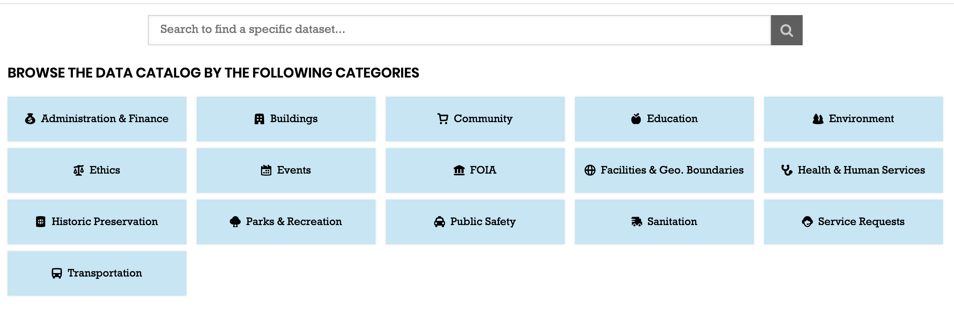

Slide 4
Beach_E_coli_Predictions.csv
Beach_Swim_Advisories.csv
Beach_Water_Quality.csv
Beach_Weather_Stations.csv

Slide 5
Data analysis of the following:
Turbidity
Wave Height
Temperature
Regression of Temperature vs. Turbidity
E. Coli

Slide 6
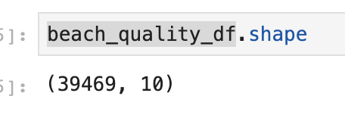
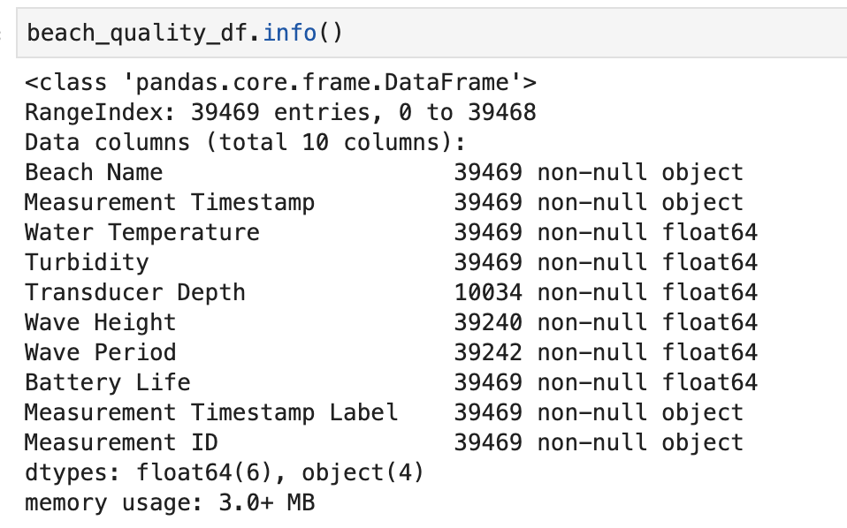

Slide 7
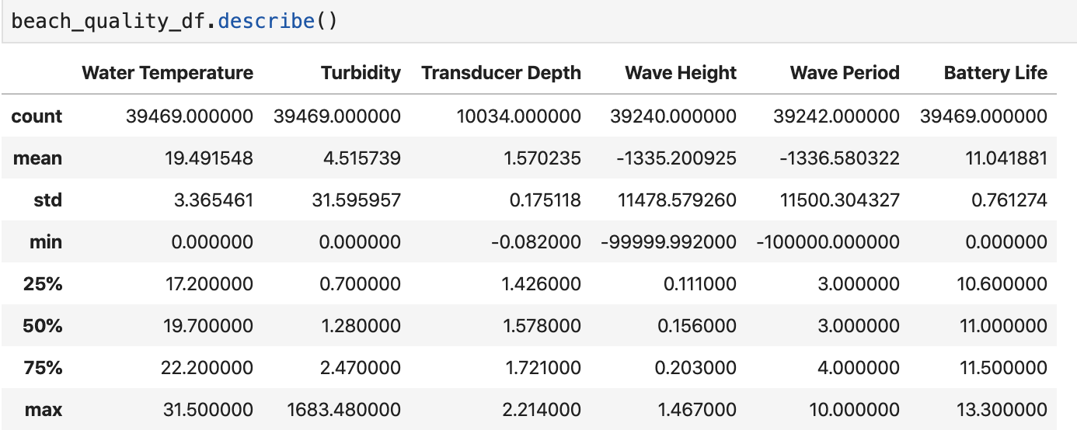

Slide 8
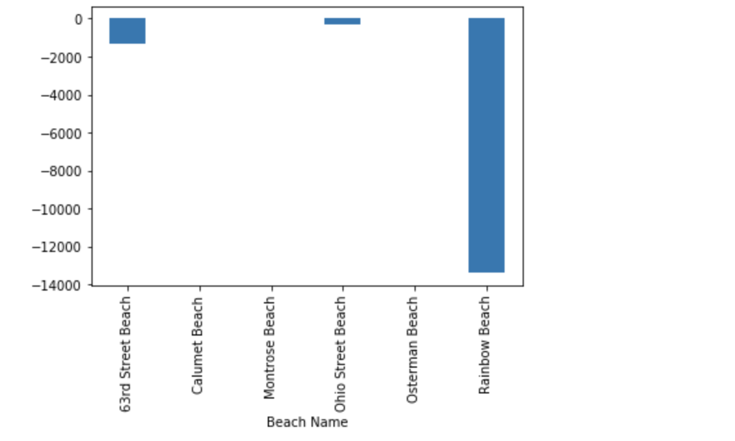

Slide 9
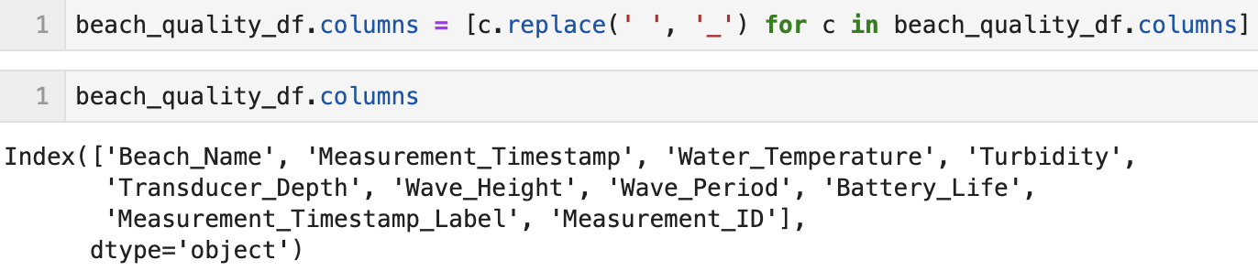

Slide 10
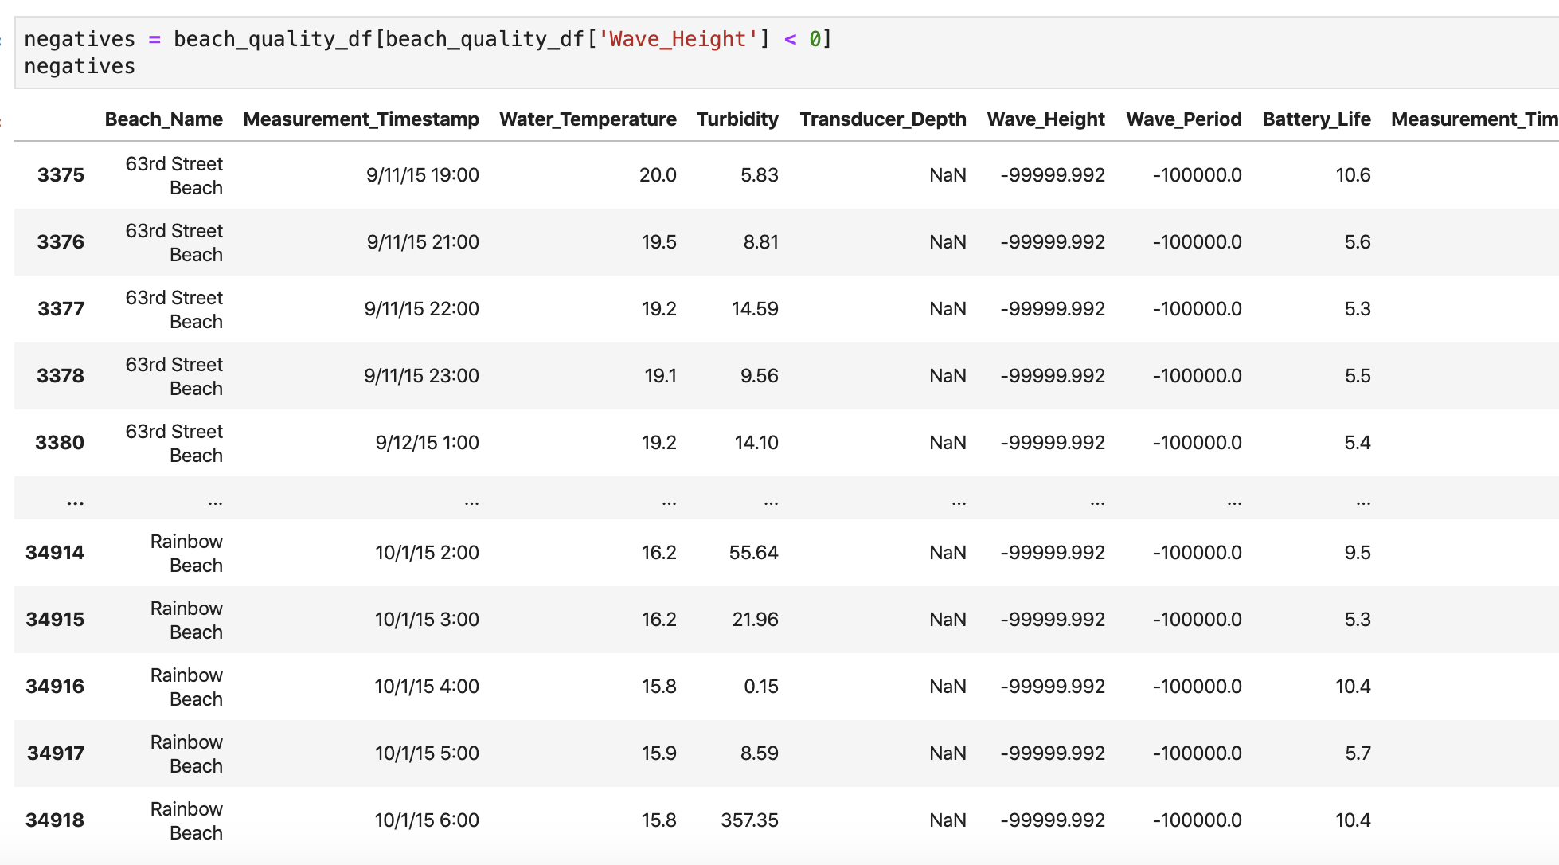

Slide 12
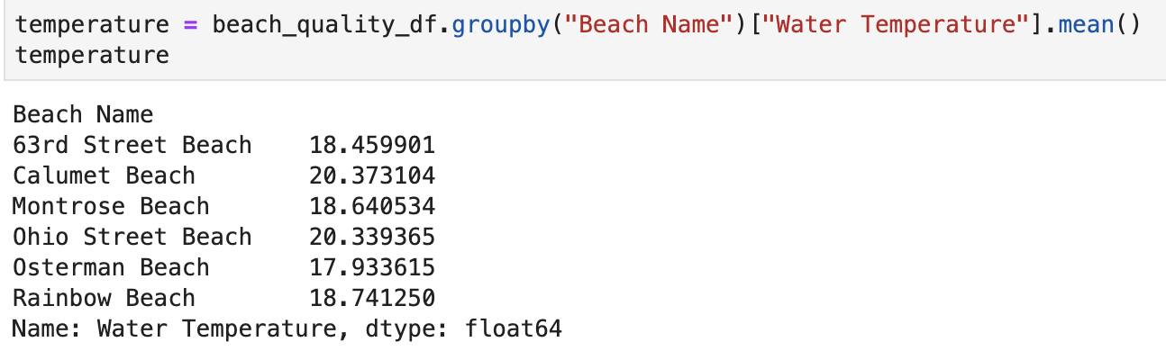

Slide 13
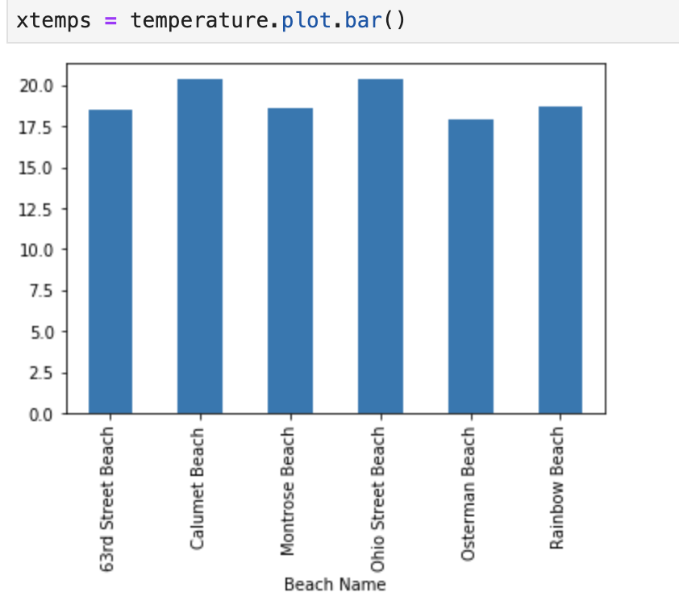

Slide 14
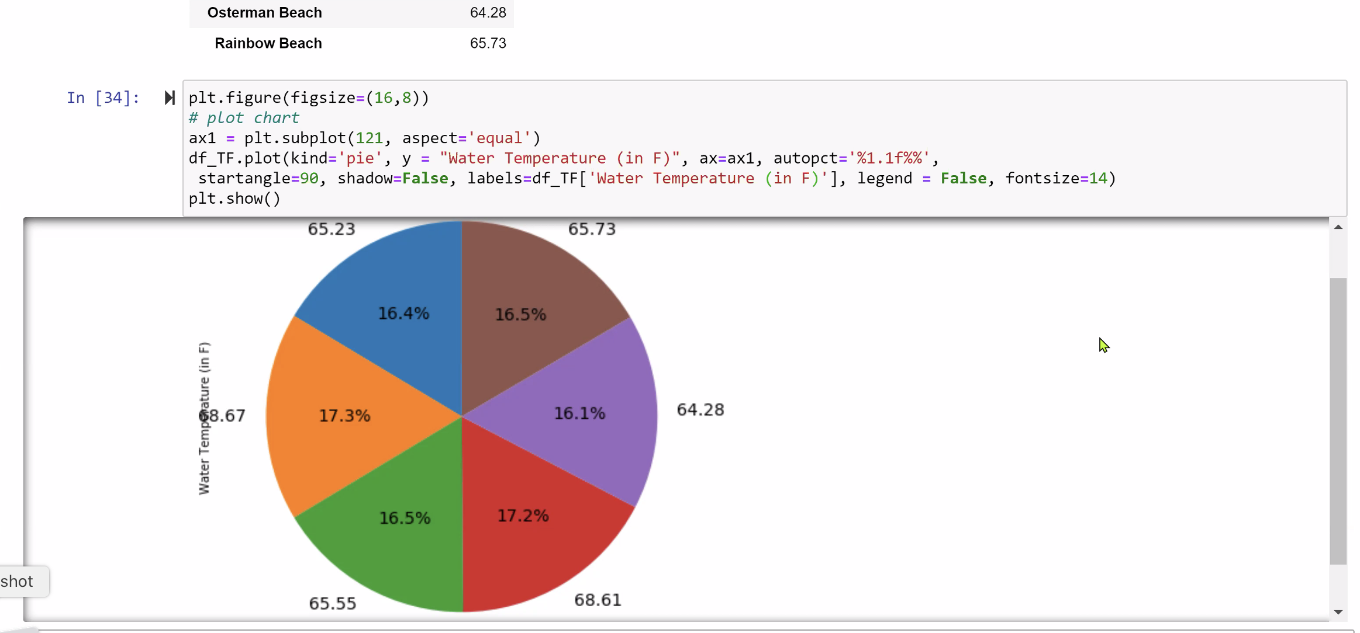

Slide 15
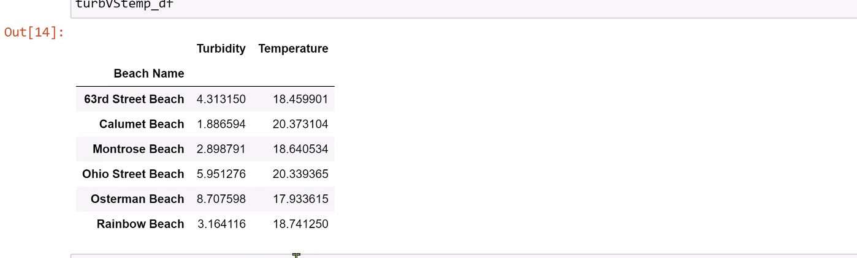

Slide 16
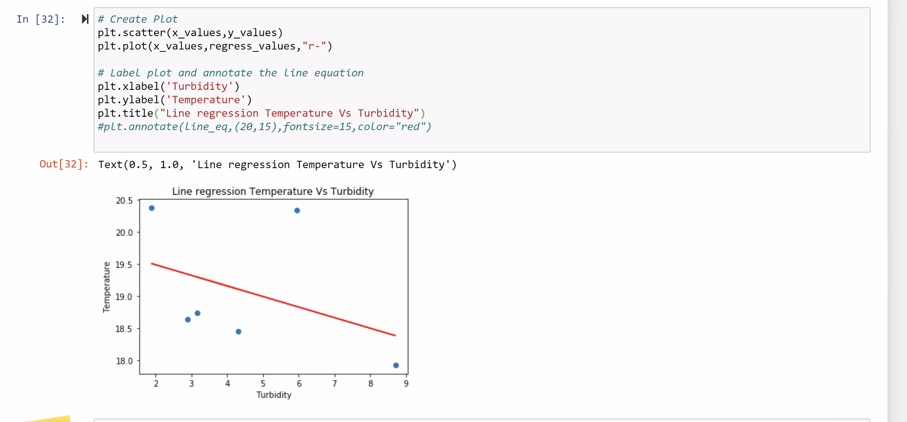

Slide 17
Which beach has the most E. Coli?

Slide 18
